Slide 1
Freedom Crossing Academy
Middle School Behavior
expectation Assembly
2024

Slide 2
Who’s Who in Middle School Mrs. Fonseca - Principal Mrs. Lime –Vice Principal Mrs. Hurst- Middle School Assistant Principal Deputy Fornash
Dean James & Dean Woollard Mrs. Moura Guidance Counselor – Room 923

Slide 3
GLOWS
GROWS
Interacting more with people (instead of being on phones)
Being kind / watching out for our younger Falcons in the hallways
-keeping hands to yourself (especially during transitions)
--tardies / being in the hallway during class

Slide 4
Appropriate Language
It is expected that students understand that any conduct or behavior that demeans, degrades, antagonizes, humiliates or embarrasses a person or group of persons, including racial slurs or derogatory comments is unacceptable and outlined in our student code of conduct as a Level II and Level III offense. FCA does not take this lightly and will follow the SJCSD Code of Conduct.
This type of offense can result in OSS.

Slide 5
Cheating / Plagiarism
At FCA, when cheating/plagiarism is founded, the student may complete a retake (at the teacher’s discretion) for up to a 75%
Notes:
Discuss the FCA Way for behavior expectations:
Focused on Safety
Committed to Responsibility
Always Respectful
These expectations are for all students and in all school settings (cafeteria, hallways, stairs, outside, classroom, bus)

Slide 6
Threat Assessments
Making threats to hurt others, their reputation, or their property
Verbal, written, or electronic communication to any person, containing a threat to harm
Level II offenses are acts of misconduct that are more serious or disruptive than offenses in
Level I. Level II also includes repeated acts of Level I misconduct, and acts directed against
people or property that do not seriously endanger the health or safety of others. A student
who commits a Level II offense may also be subject to criminal proceedings.
Level III infractions are major acts of misconduct which the School Board has determined
constitute a serious breach of conduct. They include repeated misconduct acts from Level II, serious disruptions of school order and threats to the health, safety and property of others. A student who commits a Level III offense may also be subject to criminal proceedings.

Slide 7
Fortify FL See Something, Say Something Self Harm / Harm to Others Bullying / Cyber Bullying

Slide 8
Cell Phone/Technology Policy
Students may possess cellular telephones and other wireless communication devices at school, on and at school functions. However, they must be turned off, stored in student’s backpack. The device shall not be used during the school day without administrative approval.
Repeated failure to comply will be considered defiance of school.
Please see the student code of conduct for more detailed information.
For medical conditions, you can reach out to Nurse Lauri Frost

Slide 9
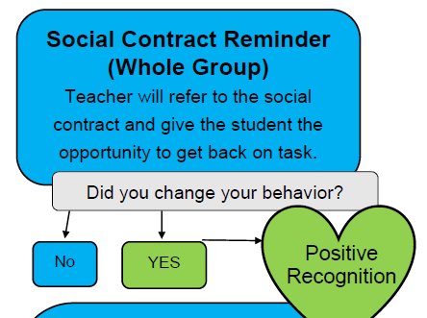
Behavior Expectations & Documentation
When a student violates the behavioral expectations, teachers will go through this process:
Step 1 →

Slide 10
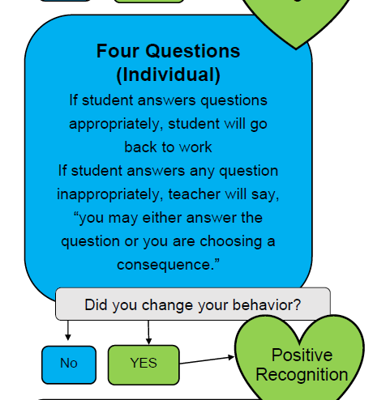
Step 2 →

Slide 11
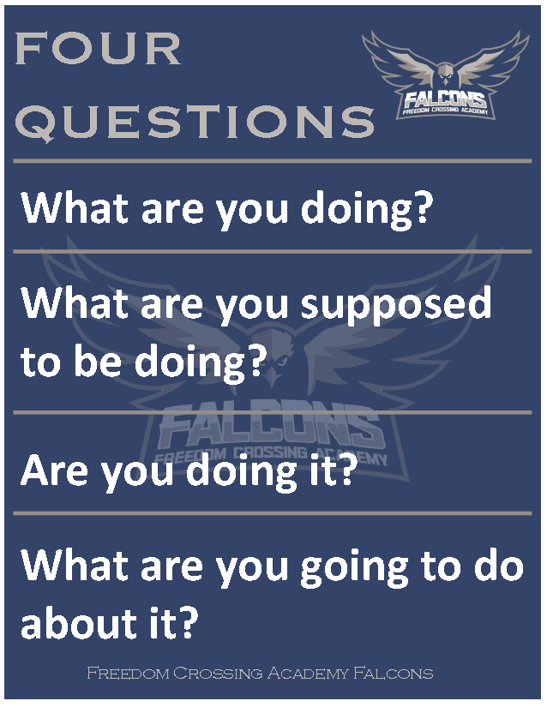
The Four
Questions

Slide 12
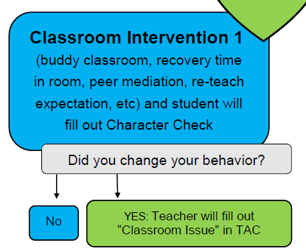
Step 3 →

Slide 13
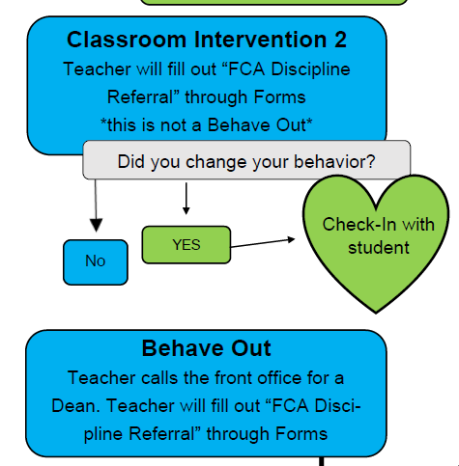
Step 4 →
Step 5 →

Slide 14
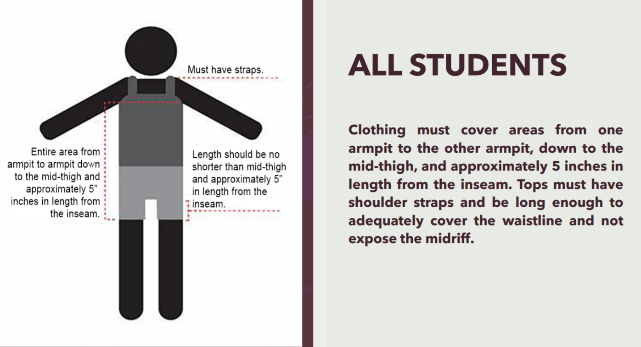
St. Johns County School District Dress Code Policy
-No hoods up / hats
-No crop tops
When a staff member dress codes you, walk to the front office and check in with Mrs. Richard/Mrs. Huber.

Slide 15
Tardy policy

Slide 16
High School Registration Dates
Bartram: March 4th-5th
Nease: March 6th
Creekside: March 7th
If you need help or have questions regarding academies/other HS options, reach out to Mrs. Moura (school counselor)

Slide 17
BE A LEADER! BE A FALCON!
If you see any of the following:
* *A student struggling to make friends
*A student being picked on
*A student who is new, shy, or not in the “in crowd”
*A student who is eating lunch alone
What to do: Say hi. Smile at them. Ask if you can sit with them. Include them. You never know what that person is facing inside or outside of school.
YOUR KINDNESS WILL MAKE A DIFFERENCE IN SOMEONE’S LIFE.

Slide 18
Take Flight & Break Barriers

